Slide 1
Using Altea LPMs
Project Setup
Using the Mega Wizard
Project Results
Simulating with ModelSim

Slide 2
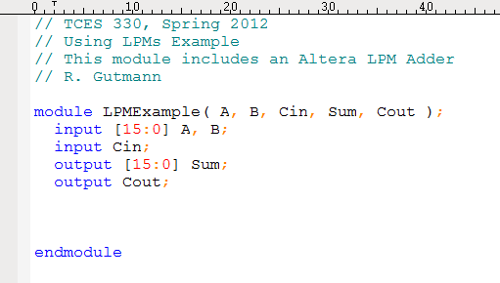
Bare Bones Module
We are going to use Altera’s LPM Adder

Slide 3
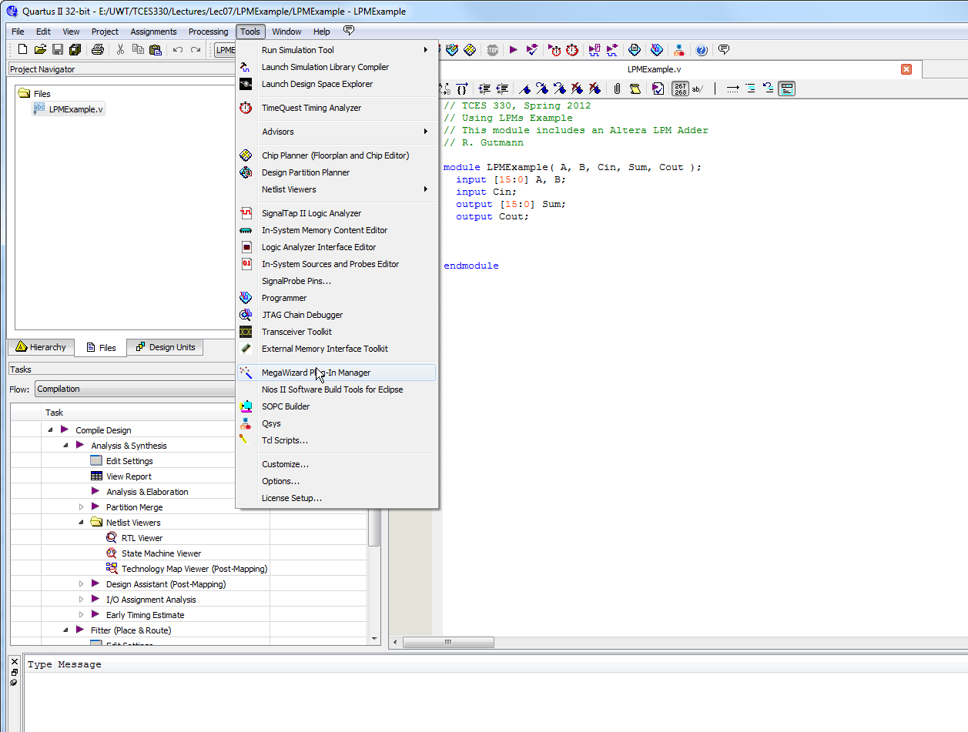
Create Quartus Project
Set up your project and select the Mega Wizard from the Tools menu

Slide 4
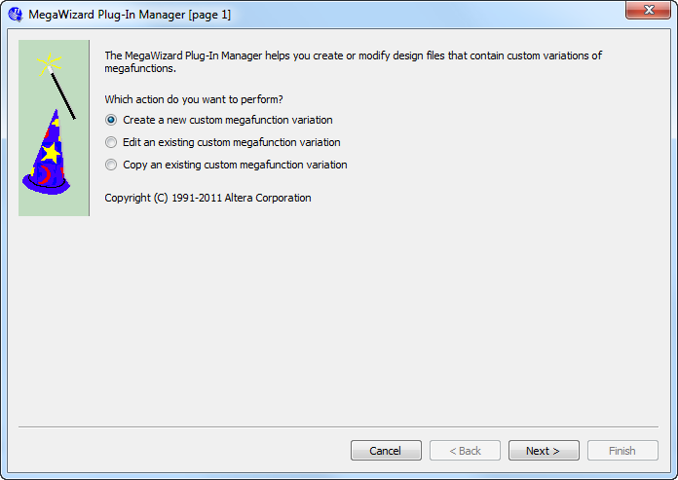
Mega Wizard Page 1

Slide 5
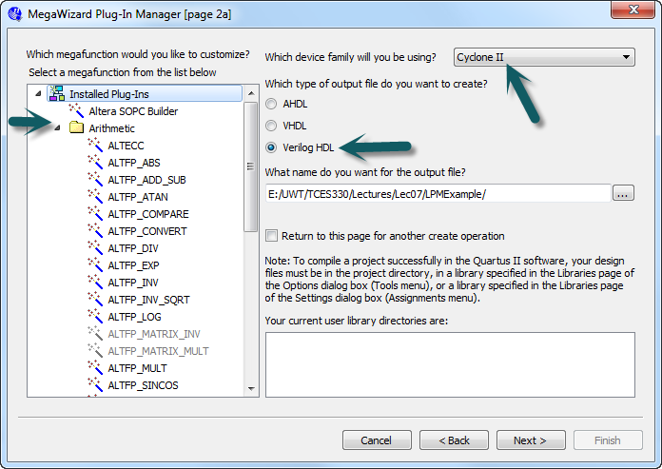
Mega Wizard Page 2
Look Through List of Plug-Ins
Make sure

Slide 6
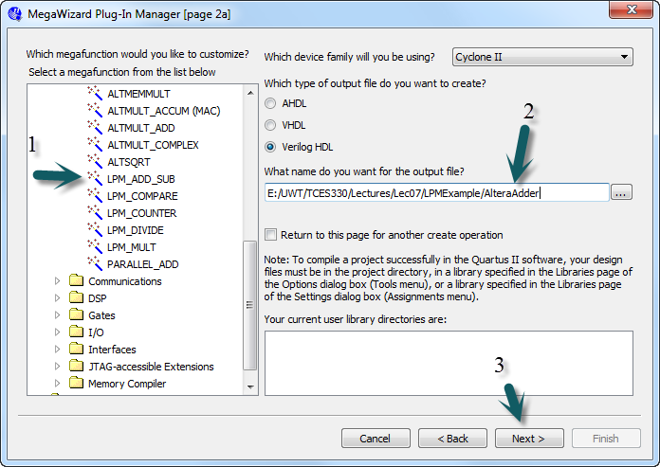
Page 2, continued
Name it
Select the
One you want
Next

Slide 7
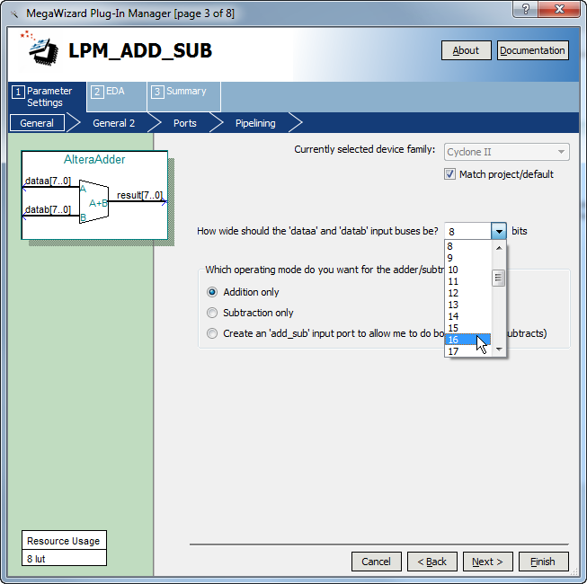
Mega Wizard Page 3
Select 16 bit to match our project.
We’ll build an Addition-only
adder

Slide 8
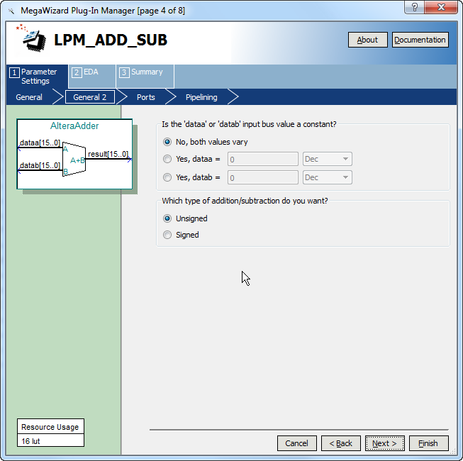
Mega Wizard Page 4
We’ll keep the defaults here.

Slide 9
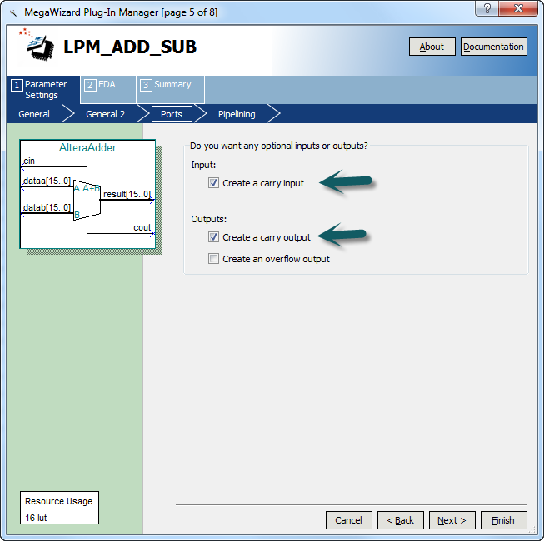
Mega Wizard Page 5
We’ll make these selections to match our project

Slide 10
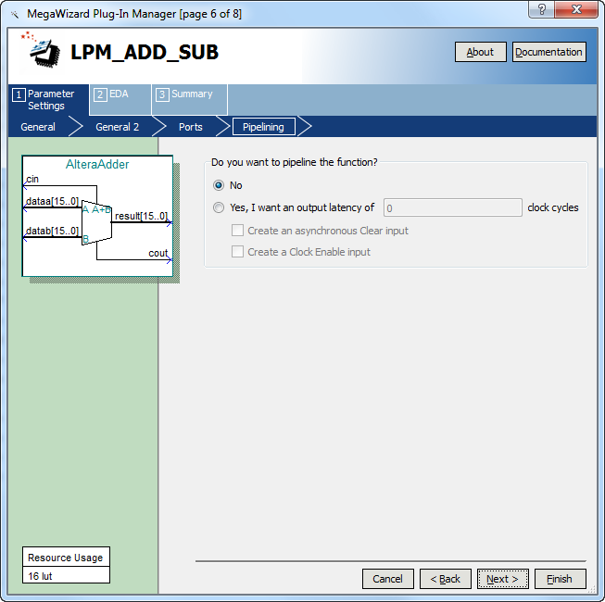
Mega Wizard Page 6
Keep the defaults

Slide 11
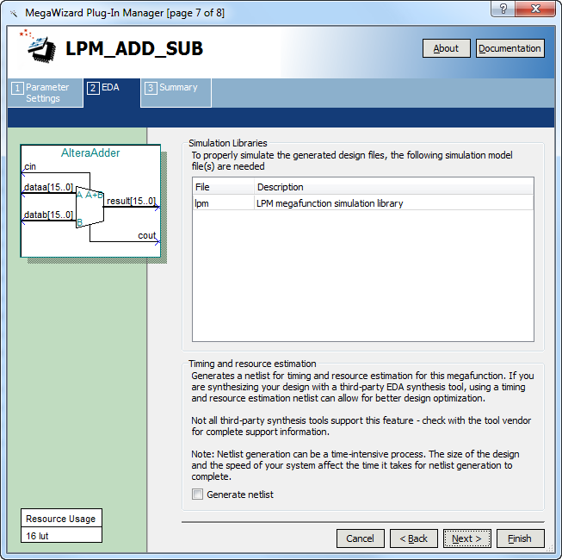
Mega Wizard Page 7
Keep the defaults

Slide 12
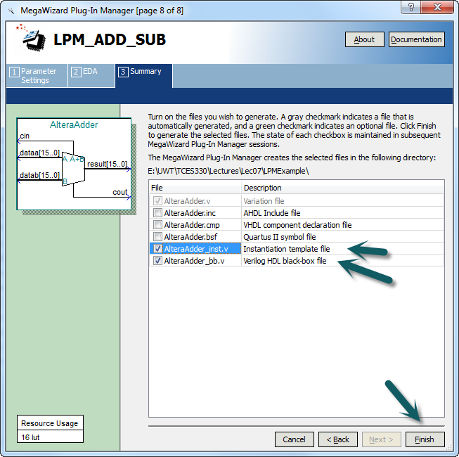
Mega Wizard Page 8
Make these selections and click Finish

Slide 13
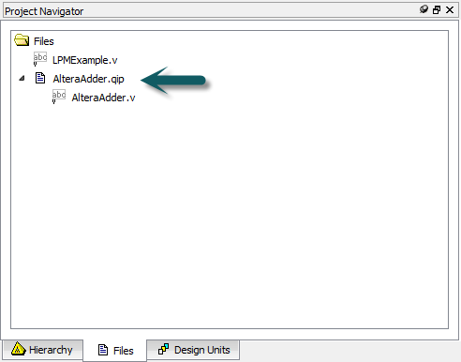
Back to Quartus
Quartus added the Adder to our project

Slide 14
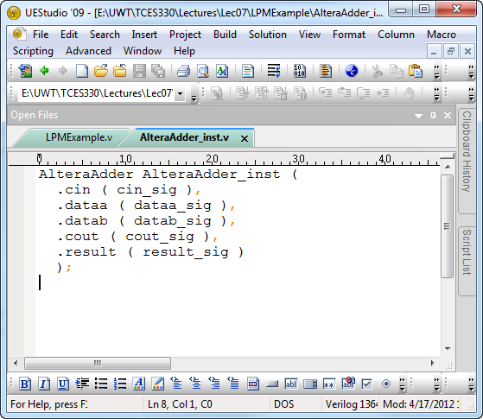
Open the Template File
Copy all these lines of Verilog

Slide 15
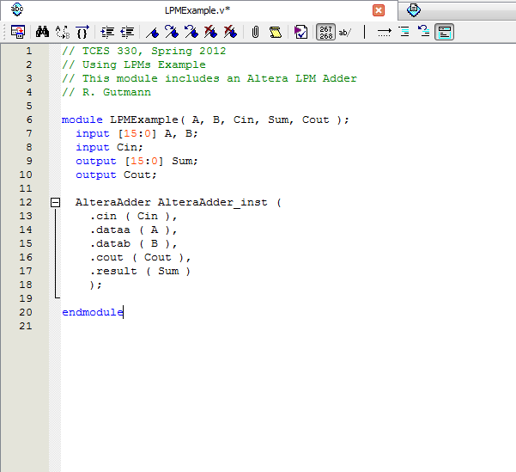
Back in the Quartus Editor
Paste them here and fill in our variable names.
Now save this file and compile the project.

Slide 16
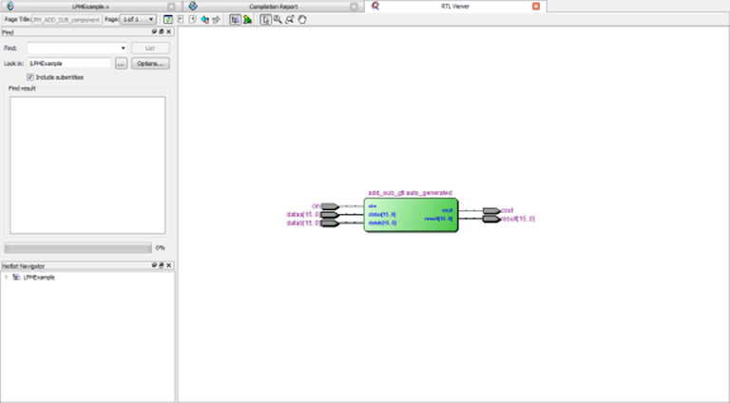
RTL View

Slide 17
“Using Altera LPMs Part 2” will cover testing with LPMs using ModelSim

